Slide 1
Clontarf Promenade Development & Flood Defence Project
Councillors Briefing.
27th January 2015
Flood Defences
Gerard O’Connell, Engineer-in-Charge

Slide 2
Royal HaskoningDHV – assistance to DCC
Dublin Coastal Flooding Protection Project (DCFPP) -
April 2005
This was a strategic examination of the risk of tidal flooding to various frontages in Dublin Bay, outlining some potential solutions for the Clontarf frontage.
Tidal surge early warning system
Flood mapping
Developed Design Criteria for Option 5 - 2006
Benefit Cost Analysis - 2009
Workshop Presentation - 2012 Considering up to date data regarding climate change

Slide 3
Quotation from the Executive Summary of the Clontarf Promenade and Flood Defence Inception Workshop of 23 October 2012
…. there is also an acceptance of the need for flood defences. The height of the flood defence must be sufficient to prevent the sea flooding the land and must also be of a sufficient height such that any water coming over the defence, due to wave overtopping will not also cause flooding.

Slide 4
Coastal Flooding - e.g. Dublin 1st February 2002
Source →
Pathway →
Receptor
Source component 1 Water level
Sea Conditions →
Source component 2 Waves
Promenade →
Houses, Roads, utilities

Slide 5
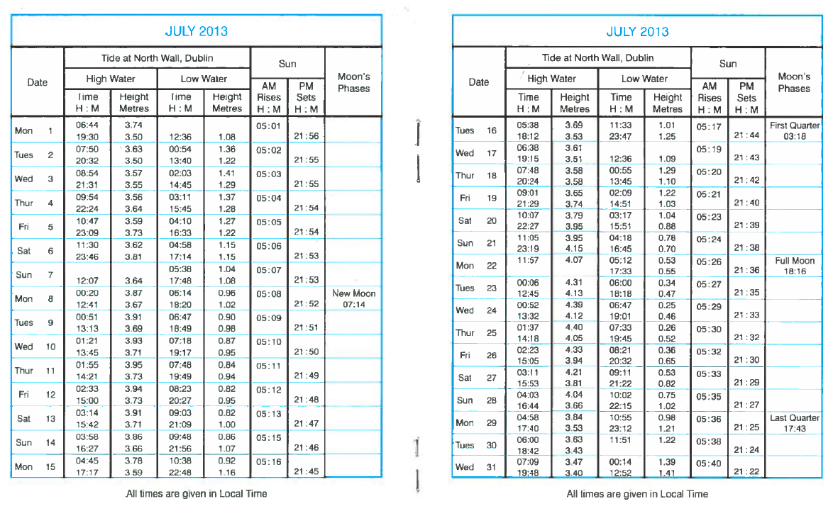
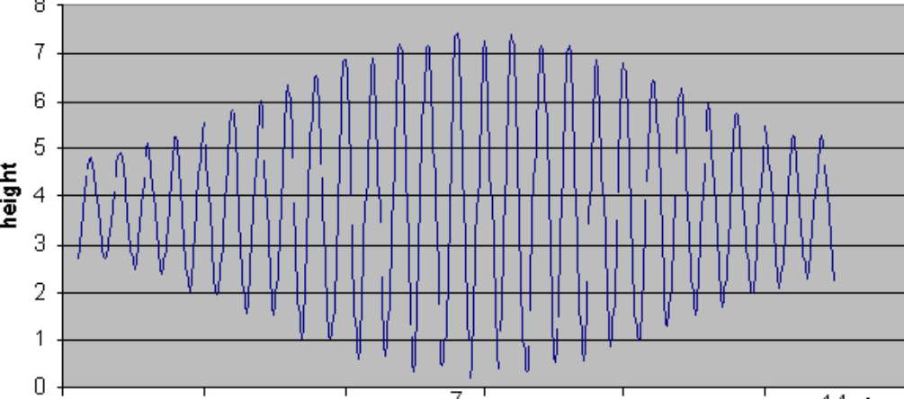
Source – 1 Components of
Still water level
Astronomical or Predicted tides
(tide tables)
2 weeks cycle of spring tides and neap tides
During spring & autumn equinoxes, the tides are larger

Slide 6
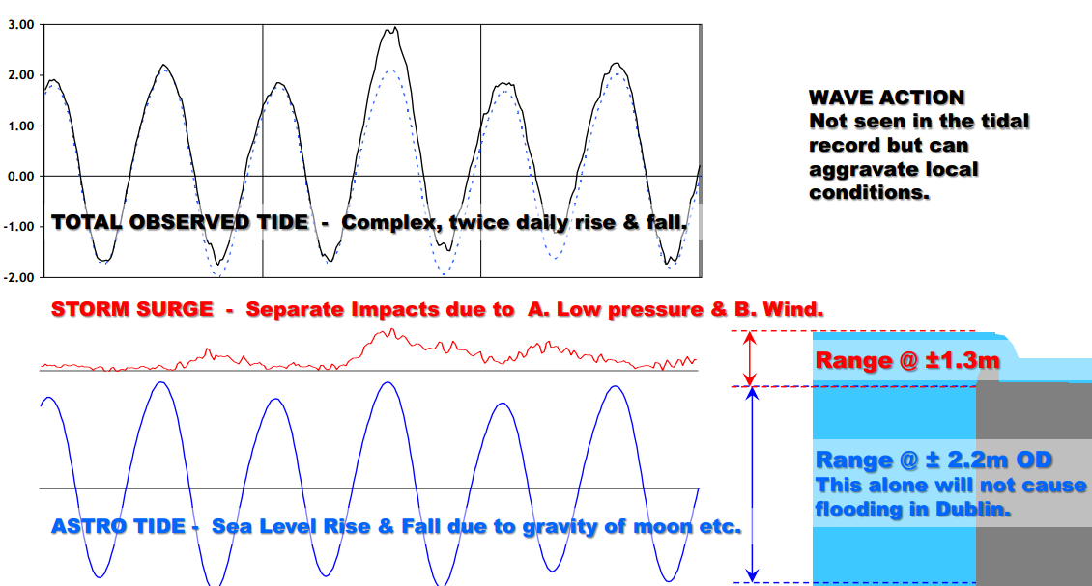
Source – 1a Components of
Still water level
Surge residual (meteorological effects,
e.g. pressure)
Max HT = 2.51
Surge = 0.54
Predicted Tide + Surge = The Design Still Water Level
Astro = 1.97

Slide 7
Source – 1b Terminology for
Still water level
Astronomical / Predicted tides mODM
metres relative to Ordnance Datum Malin
The mean sea level at Portmoor Pier, Malin Head, County Donegal, between 1960 and 1969; is the zero level for land surveying in Ireland.
Lugnaquilla, the highest peak in the Wicklow Mountains at 925 metres (3,035 feet)
MHWS (mean high water spring tide) The average of high water heights occurring at the time of spring tides
Surge principally air pressure effects, measured in metres

Slide 8
Annual peak water levels in Dublin Bay, 2000 to 2012 – tide + surge components

Slide 9
Dublin Bay
Annual Exceedance Probability (AEP)
0.1%
0.2%
0.5%
1%
2%
5%
10%
20%
50%
Extreme levels Yrs (2002) | mODM
1000 | 3.31
500 | 3.24
200 | 3.13
100 | 3.03
50 | 2.91
20 | 2.75
10 | 2.61
5 | 2.48
2 | 2.35
HAT | 1.99
MHWS | 1.59
MHWN | 0.89
MSL
MLWN | -1.01
MLWS | -1.81
LAT | -2.61
Surge component above MHWS (m)
1.59 m
1.65 m
1.54 m
1.44m
1.32 m
1.16 m
1.02 m
0.89 m
0.76 m
The Design (Extreme) Still Water Level =
Predicted Tide +
Surge

Slide 10
Climate Change
Sea level rise
 | Up to 2025 | 2026-2050 | 2051-2080 | Current total estimate for 2080
Current estimate | 4 mm/yr (92mm) | 7 mm/yr (175mm) | 11 mm/yr (330mm) | 597mm
 | Up to 2025 | Up to 2050 | Up to 2080
Surge | 200mm | 350 mm | 700 mm | 700mm
EA interpretation of IPCC Report 2011
increased storminess (bigger waves) &
heavier rainfall intensity

Slide 11
Source – 2 Wave action - wave size
Wind strength & duration
(controls open sea wave heights)
Wind direction
(controls open sea wave directions)
Water depth
(controls in-shore wave height at the flood defence structure – wave breaking/surf)
Combining appropriate values for these 3 elements gives the
Design Wave height (at the structure)

Slide 12
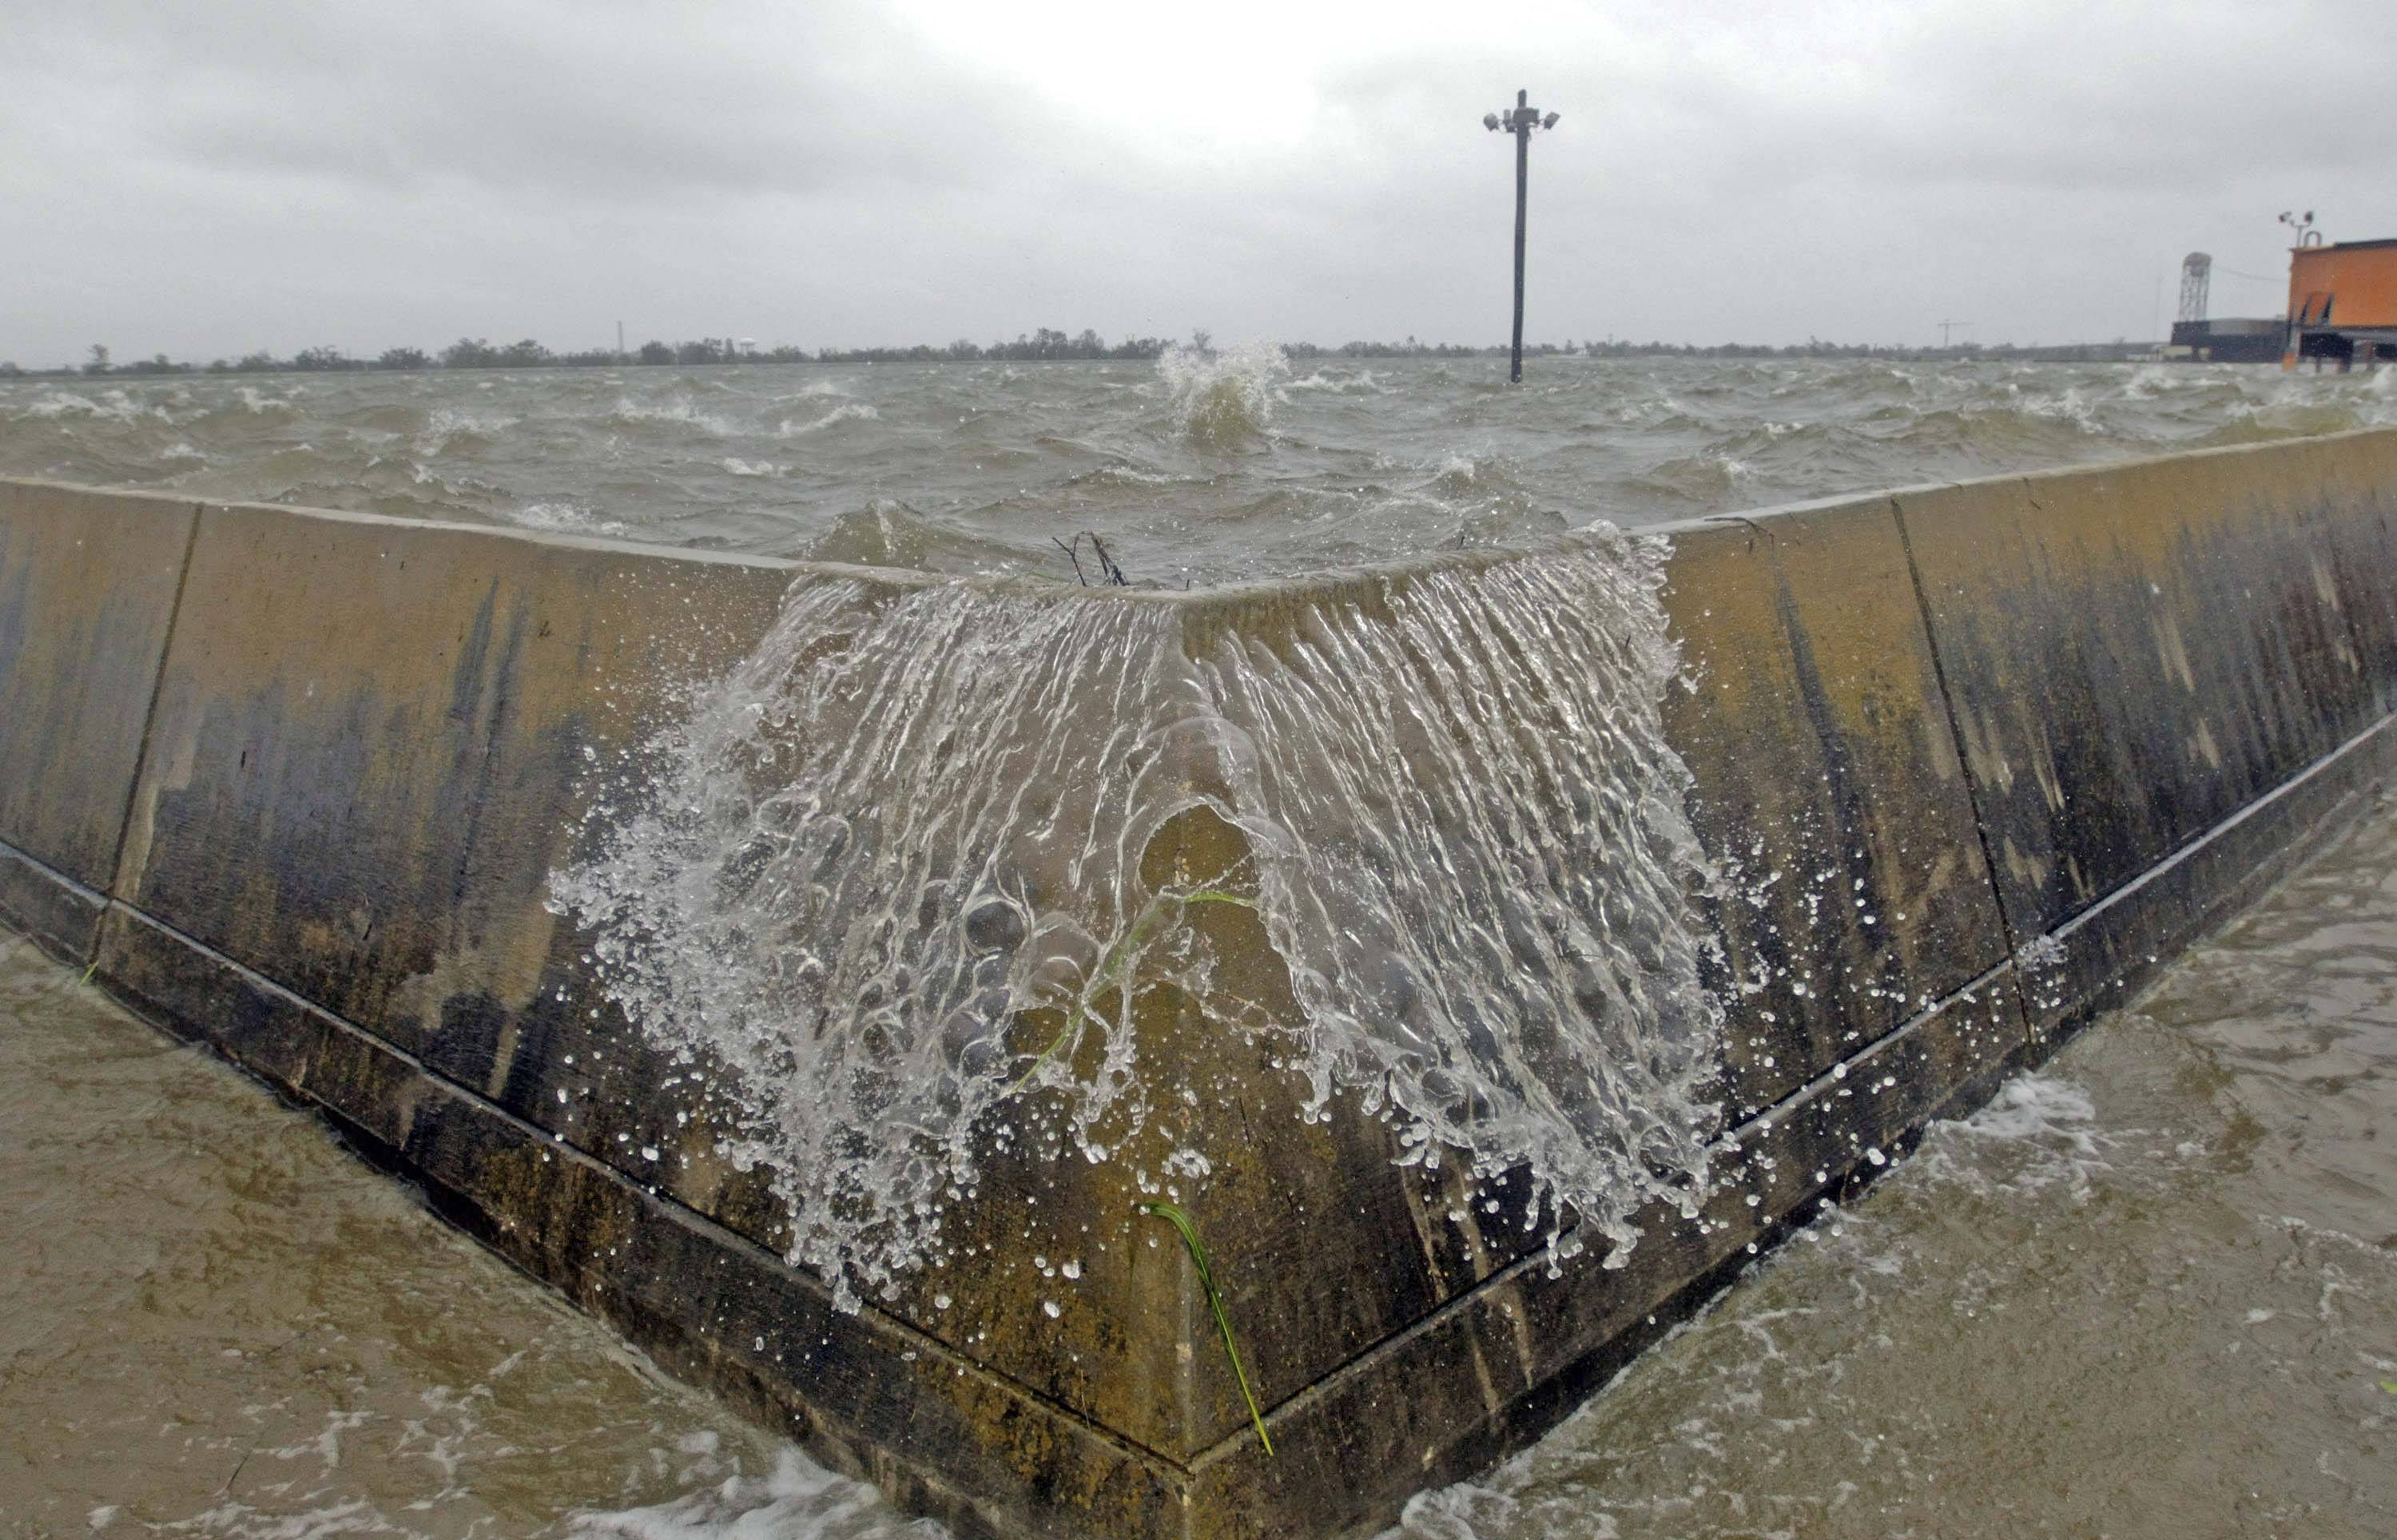
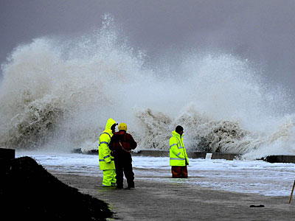
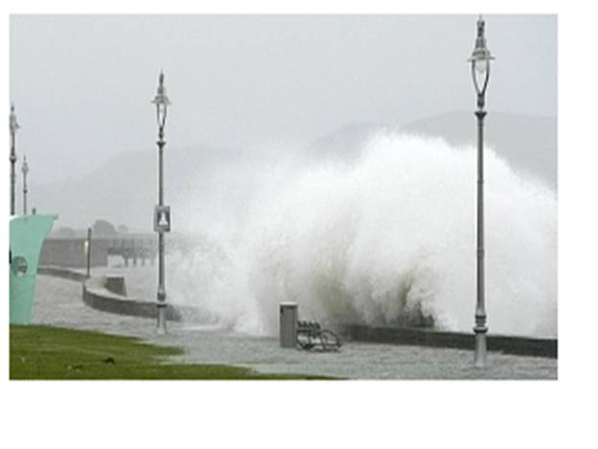
Source – 2b Consequence of wave action – overtopping

Slide 13
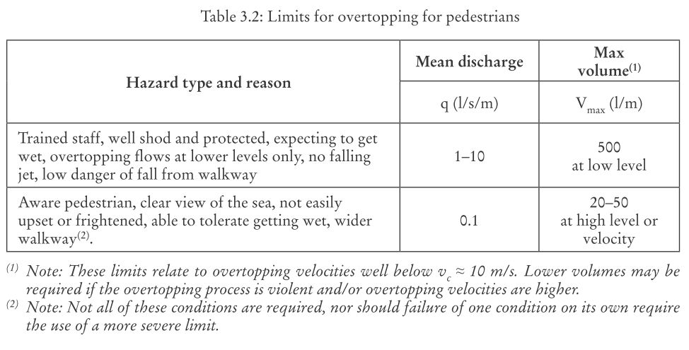
Source – 2b Consequence of wave action – overtopping
How much overtopping is a reasonable/acceptable amount?
Extracts from the Eurotop Manual 2009

Slide 14
Combination of sources 1 & 2 - Joint Probability
Extreme Still Water Level and/or an Extreme Wave Height = Flood Event
The Probability, or risk, of different combinations of still water level and wave action occurring needs to be explored.
For resident (and properties) defended by a flood alleviation scheme, it is usually most helpful to consider the probability of a number of different combination occurring,
For example
a higher water level combined with a lower wave height or
a lower water level combined with a higher wave height
Which causes the greatest overtopping/flooding?

Slide 15
So what does that mean for the residents at risk of flooding?
House insurance - companies belonging to Insurance Federation of Ireland will generally not insure properties known to be at risk of flooding, if they have a greater risk than 1% AEP (Annual Exceedance Probability) “1 in 100yr return period”,
They don’t insure eventualities!
In horse racing the ‘odds’ quoted by the bookies might be 15 to 1 (6.6% chance of winning)
The OPW guidance states that the ‘The preferred design standard applied by OPW for coastal and tidal flood defences is typically the 200 year, or 0.5% AEP event.’

Slide 16
Constraints - OPW Guidance;
Need for an Environmental Impact Statement
Flood Defence Design Standard - Typically 0.5% AEP
Benefit cost Ratio greater than 1 (now 1.6).
- Freeboard Allowance for tidal defences - Typically 300mm for hard defences 500mm for soft defences
- Climate Change Allowance for tidal defences -Typically 300mm (in 2006)
- Freeboard Allowance for tidal defences - Typically 300mm for hard defences 500mm for soft defences
- Considerations of defence failure & surface water/pluvial ponding - drainage/removal of ponding
Minimum desired height – 1.2m to avoid being
a tripping hazard

Slide 17
Technical Considerations
Defences must withstand design still water levels & wave loading impacts
No or minimal human intervention required for scheme to operate during any flood event.
Provide acceptable overtopping rates of ~0.1litre/sec/m
Low Maintenance
Geotechnical considerations
Utilities and services such as gas, electric, water, communications.
Buildabillity
Suitable provision for drainage of surface / rain water,

Slide 18
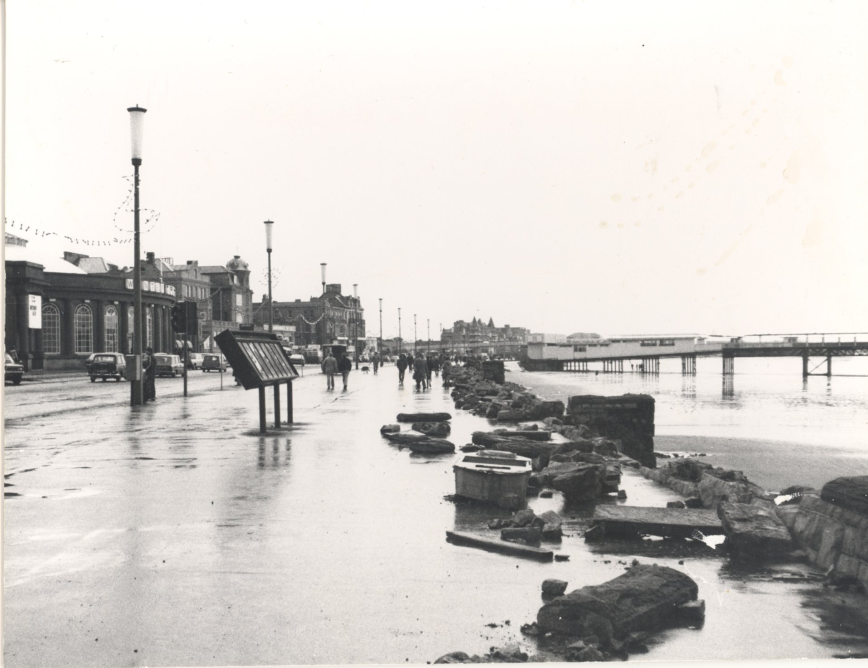
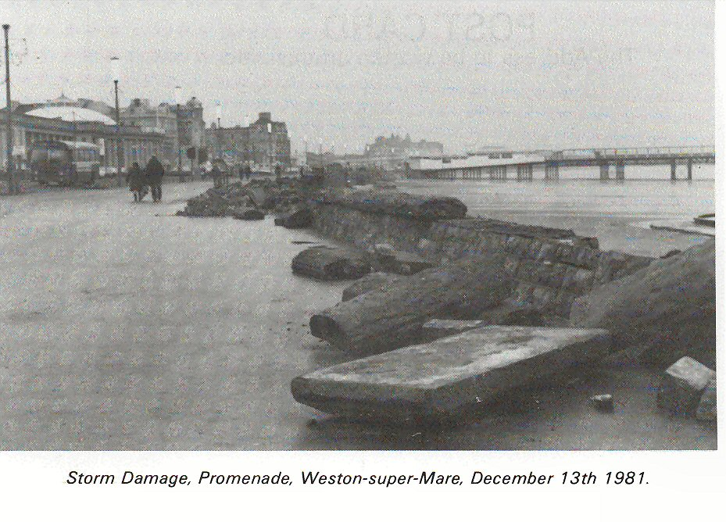
High Water Level & Waves – Parapet Wall Failure

Slide 19
Non Technical Consideration
Landscape
Aesthetics
Amenity

Slide 20
Re-cap
Design Still Water Level, comprises;
Astronomical tides
Surge component is added (or subtracted) to astro tide
Wave Height allowance
Meteorological effects
Overtopping allowance
Combined Effects – Joint Probability
Probability 0.5% AEP (1 in 200yr) - insurance implications
OPW Guidance
Climate change
Technical considerations e.g. freeboard

Slide 21
Pulling the components together
5. Free board
~ 0.3m
4. Allowance for climate change
0.88m (2035 to 2080)
0.42m (2002 to 2035)
3. Allowance to control overtopping to an acceptable amount
Varies depending on location, say between 0.2 & 0.5m
2. Wave height allowance
Varies depending on location say between 0.5 & 1m
1. Design Still Water Level
~ 3.17m ODM

Slide 22
Potential Options
There are many many possible options for a scheme layout, but only two basic options have been briefly considered for this presentation
New Seawall close to alignment of existing seawall
2. New Seawall close to alignment of Clontarf Road

Slide 23
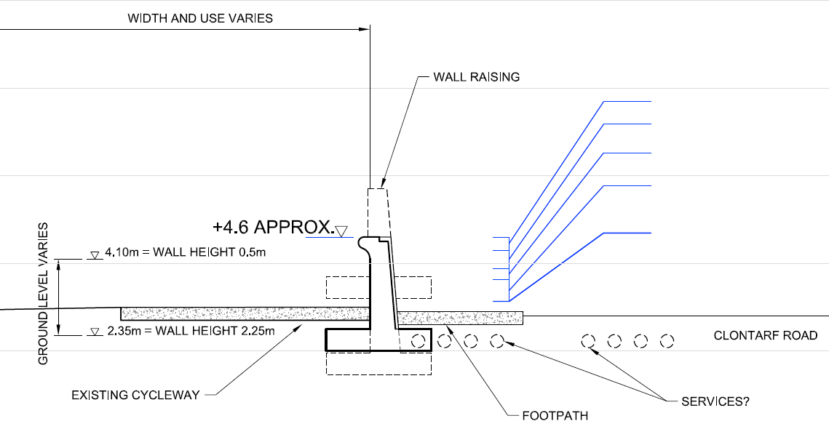
Flood Defence adjacent to Clontarf Road
Freeboard allowance ~ 0.3m
Climate Change allowance ~ 0.42m
Overtopping allowance ~ 0.25m
Wave height allowance ~ 0.5m
Design Still Water Level ~ 3.13mODM

Slide 24
Conclusions
Any scheme needs to reduce the risk of flooding to the properties of Clontarf to be 0.5% AEP (1 in 200yr), if OPW funding is to be sought
The worst combination of (extreme) Still Water Level and (extreme) Wave Height, that has a joint probability of 0.5% AEP, has to be identified for each section of the frontage, and for the chosen alignment of the flood defence, to provide the design standard of flood defence

Slide 25
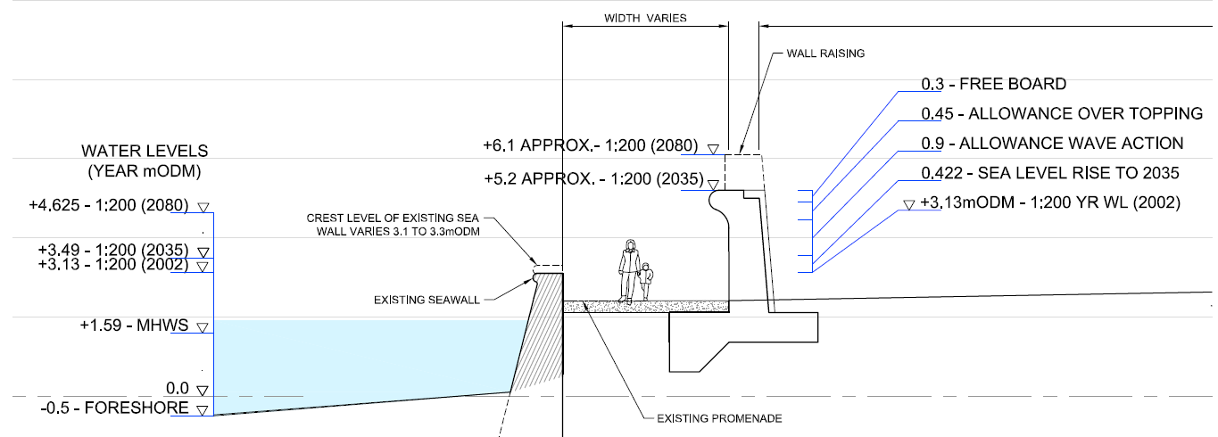
Flood Defence adjacent to Existing Seawall

Slide 26
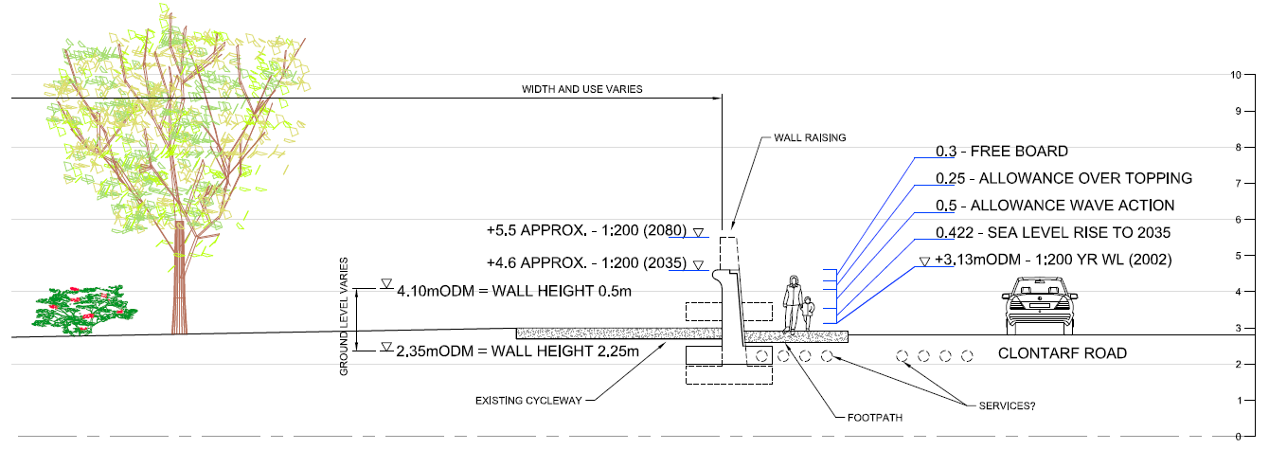
Flood Defence adjacent to Clontarf Road

